Slide 1

Chapter 4
SOCIAL INTERACTION

Slide 2
Overview
Being social
Face to face conversations
Remote conversations
Tele-presence
Co-presence
Shareable technologies

Slide 3
Conversational mechanisms
Various mechanisms and ‘rules’ are followed when holding a conversation, e.g. mutual greetings
A: Hi there
B: Hi!
C: Hi
A: All right?
C: Good, how’s it going?
A: Fine, how are you?
C: OK
B: So-so. How’s life treating you?

Slide 4
Being social
Are F2F conversations being superseded by our social media interactions?
How many friends do you have on Facebook, LinkedIn,etc vs real life?
How much overlap?
How are the ways we live and interact with one another changing?
Are the established rules and etiquette still applicable to online and offline?
Notes:
Are the ways we live and interact with one another changing? Have the conventions, norms and rules–that have been established in face-to-face interactions to maintain social order been able to migrate to social media interactions? In particular, are the established conversational rules and etiquette – whose function it is to let people know how they should behave in social groups – also applicable to online social behaviour?
4

Slide 5
Conversational rules
Sacks et al. (1978) work on conversation analysis describe three basic rules:
Rule 1: the current speaker chooses the next speaker by asking an opinion, question, or request
Rule 2: another person decides to start speaking
Rule 3: the current speaker continues talking

Slide 6
Conversational rules
Turn-taking used to coordinate conversation
A: Shall we meet at 8?
B: Um, can we meet a bit later?
A: Shall we meet at 8?
B: Wow, look at him?
A: Yes what a funny hairdo!
B: Um, can we meet a bit later?
Back channelling to signal to continue and following
Uh-uh, umm, ahh

Slide 7
More conversational rules
Farewell rituals
Bye then, see you, yer bye, see you later….
Implicit and explicit cues
e.g. looking at watch, fidgeting with coat and bags
explicitly saying “Oh dear, must go, look at the time, I’m late…”

Slide 8
Breakdowns in conversation
When someone says something that is misunderstood:
Speaker will repeat with emphasis:
A: “this one?”
B: “no, I meant that one!”
Also use tokens:
Eh? Quoi? Huh? What?

Slide 9
What happens in social media conversations?
Do same conversational rules apply?
Are there more breakdowns?
How do people repair them for:
Phone?
email?
Instant messaging?
texting?
Skyping?
Notes:
have new conversational mechanisms evolved for the various kinds of social media? For example, do people greet each other in the same way, depending on whether they are chatting online, Skyping or at a party? Do people take turns when online chatting in the way they do when talking with each other face-to-face? In order to answer these questions we next describe the core social mechanisms that exist in face-to-face interactions, followed by a discussion of the extent to which they remain or have been replaced with other mechanisms in online interactions.
On the phone: The person answering the call will initiate the conversation by saying “hello” or more formally, the name of their company/department (and sometimes the phone number being called). Many phones now have caller ID letting the person answering the call know who he is talking to, which can enable him to be more personal, e.g. “Hello John, how are you doing?” Phone conversations usually start with a mutual greeting and end with a farewell one.
In contrast, conversations that take place via online chatting or IM have evolved new conventions. The use of opening and ending greetings when joining and leaving are rarely used; instead most people simply start their message with what they want to talk about, and then stop when they have got an answer, as if in the middle of a conversation
9

Slide 10
Remote conversations
Much research on how to support conversations when people are ‘at a distance’ from each other
Many applications have been developed
e.g., email, videoconferencing, videophones, instant messaging, chatrooms
Do they mimic or move beyond existing ways of conversing?

Slide 11
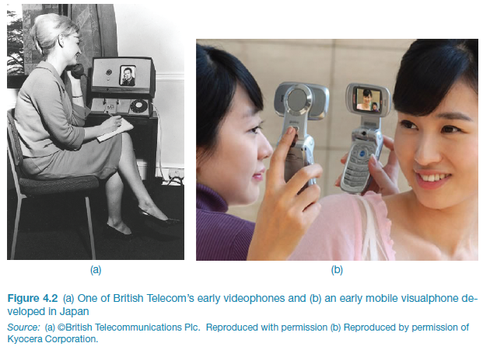
Early videophone and visualphone
Notes:
Figure 4.1

Slide 12
VideoWindow system (Bellcore, 1989)
Shared space that allowed people 50 miles apart to carry on a conversation as if in same room drinking coffee together
3 x 8 ft ‘picture-window’ between two sites with video and audio
People did interact via the window but strange things happened (Kraut, 1990)
Notes:
12
Two lounge areas, that were 50 miles apart, were connected with high bandwidth video channels and full duplex four channel audio. Connecting them was a 3 by 8 foot wide ‘picture-window’, onto which video images were projected. The large size was meant to allow those viewing it to see a room of people roughly the same size as them. The system was designed to be active 24 hours a day, whereby anyone entering one room could speak to whoever happened to be in the other room.
A study by Kraut et al (1990) of how effective the system was, showed that in general, many of the interactions that took place between the co-located conversants were indeed indistinguishable from similar face-to-face interactions – with the exception that they spoke a bit louder and constantly talked about the video system. However, they also found that people who were in the same room tended to talk more with each other than with those in the video-linked room. Various usability problems were identified as contributing to this reluctance to talk with video-images of other people. One of these was the tendency for people to move closer to the picture-window to strike up a conversation with someone (which is what one would normally do in a face-to-face setting), but which had the opposite effect of what the person intended, as it moved their head out of the picture (since they were no longer under the camera) and also out of microphone range, meaning they could not be seen or heard. Thus rather than getting nearer to the other person they wanted to talk to, their behavior had the counter-intuitive effect of removing them from the ‘picture’. Moreover, there was no way of each participant knowing whether they were being seen and heard by the others in the other room. This inability to monitor how the other person is or not ‘receiving’ you caused numerous problems. Another problem that became apparent was that the system only allowed public conversations, meaning that they could be heard by everyone in the rooms. Such public broadcasting contrasts with how people normally engage in informal face-to-face conversations, where they will often whisper and conspire with each other when a topic becomes more private or secret. Such private conversations were clearly not able to be supported by the VideoWindow system.

Slide 13
Sketch of VideoWindow

Slide 14
Findings of how VideoWindow System was used
Talked constantly about the system
Spoke more to other people in the same room rather than in other room
When tried to get closer to someone in other place had opposite effect - went out of range of camera and microphone
No way of monitoring this

Slide 15
Skype success
Global household name
Seeing others on screen enables more intimacy than audio phone
Enables people to get to know each other better
Less awkward for young children
Like “to show, not tell” (Ames et al, 2010)
Notes:
Skype, has now become a household name, and is one of the most popular forms of online conversation worldwide. Families who live in different places now regularly keep in touch with each other via skype, for daily, weekly and special occasion catch-ups. Seeing each other on the screen enables more intimacy and connectedness, allowing, for example, grandparents and grandchildren living in different countries to get to know each other better than if they only kept in touch using an audio phone. Moreover, it has been found that children prefer having a conversation using videoconferencing compared with only using an audio phone, as it can be less awkward for them, enjoying the ability to “show, not tell” things to their relatives (Ames et al, 2010).
15

Slide 16
3D virtual worlds
Second Life (2007)
Over 8 million users
What kinds of conversation take place in these environments?
VoIP versus chatroom talk?
Which is preferred and why?
Notes:
The options of VoIP, speech bubbles or chatboxes are provided to enable the users to talk to one other. An ongoing debate is whether the richness of voice is preferable to the anonymity of text. Which is preferred depends on the context and varies from person to person. VoIP works better for small groups as it is difficult to distinguish between more than a few voices while text can be used for much larger groups. A study by Wadley et al (2009) found VoIP to be judged to be richer than text as it enables people to express nuances of meaning more quickly. However, some people preferred using text as it allows them to have more control over how they appear to others, while also enabling them to multi-task and hold multiple conversations at the same time. Others simply did not like the sound of their own voice. Introverted people also tend to prefer to type rather than speak.
16

Slide 17
Facebook and Twitter
Everyone uses them so what is there to learn?
Used in emergencies, demos, etc.,
e.g., users spread up-to-the minute info and retweet about how a wildfire or gas plume is moving
but can also start or fuel rumours, by adding news that is old or incorrect
more confusing than helpful
Notes:
However, the reliability of the tweeted information can be a problem. For example, some people end up obsessively checking and posting, and sometimes without realizing can start or fuel rumors, by adding news that is old or incorrect. Regular Twitterers can go into a feeding frenzy, constantly adding new tweets about an event as witnessed when an impending flood was announced (Starbird et al, 2010). While such citizen-led dissemination and retweeting of information from disparate sources is well intentioned, it can also flood the twitter streams, making it difficult to know what is old, actual or hearsay.
17

Slide 18
Telepresence
New technologies designed to allow a person to feel as if they were present in the other location
projecting their body movements, actions, voice and facial expressions to the other location or person
e.g. superimpose images of the other person on a workspace

Slide 19
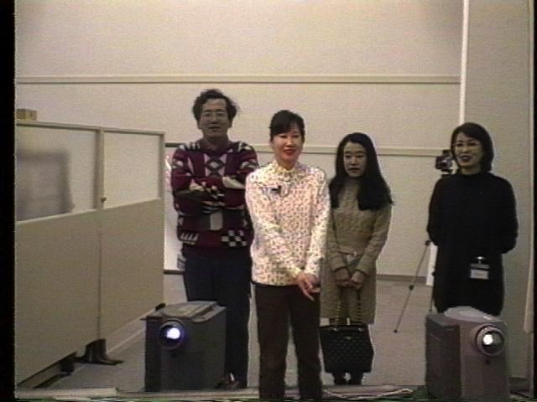
Hypermirror (Morikawa and Maesako, 1998)
allows people to feel as if they are in the same virtual place even though in physically different spaces
(woman in white sweater is in a different room to the other three)
People in different places are superimposed on the same screen to make them appear as if in same space

Slide 20
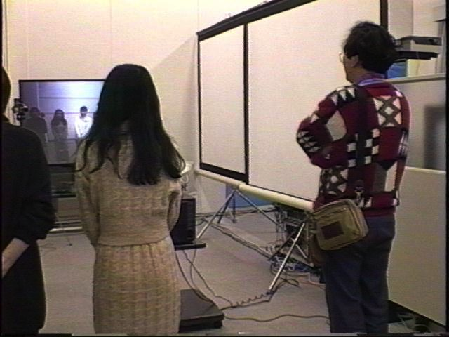
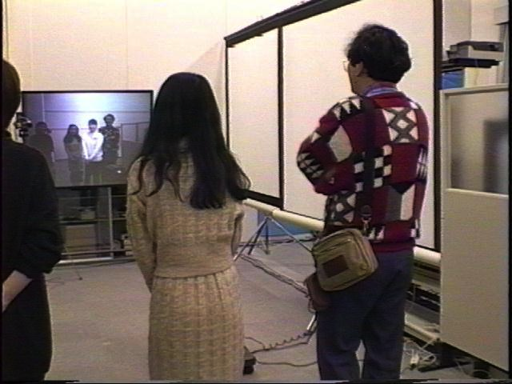
Creating personal space in Hypermirror
2) Two in this room are invading the ‘virtual’ personal space of the other person by appearing to be physically on top of woman in white sweater
3) Two in the room move apart to allow person in other space more ‘virtual’ personal space

Slide 21
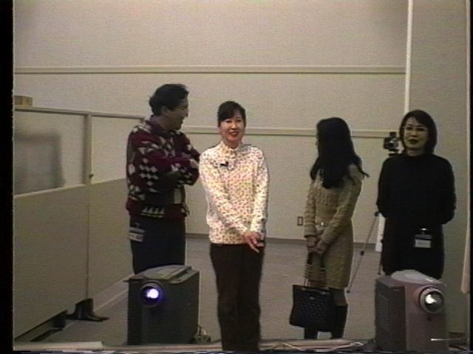
Everyone happy

Slide 22
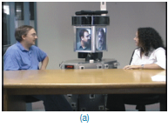
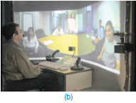
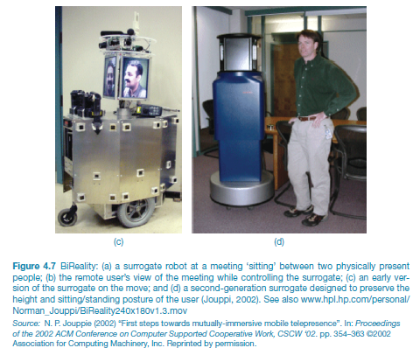
BiReality

Slide 23
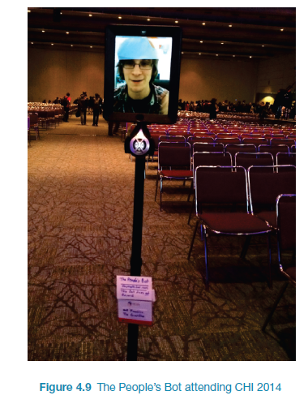
The People’s Bot attending CHI

Slide 24
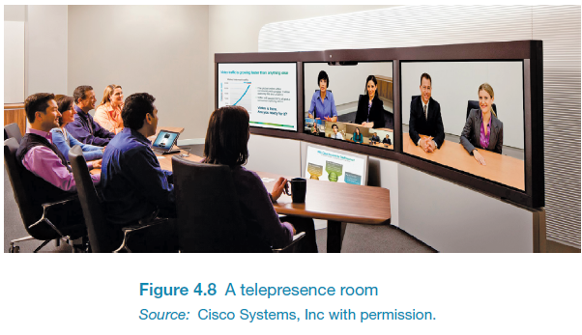
A telepresence room

Slide 25
How much realism?
Is needed in telepresence to make it compelling?
Telepresence rooms try make the remote people appear to be life-like by using multiple high def cameras with eye-tracking features and directional microphones
Is Skype just as good?

Slide 26
Coordination mechanisms
When a group of people act or interact together they need to coordinate themselves
e.g., playing football, navigating a ship
They use:
verbal and non-verbal communication
schedules, rules, and conventions
shared external representations

Slide 27
Co-presence
Technologies that enable co-located groups to collaborate more effectively
when working, learning and socializing
Examples: Smartboards, Surfaces, Wii and Kinect

Slide 28
F2F coordinating mechanisms
Talk is central
Non-verbal also used to emphasize and as substitute
e.g. nods, shakes, winks, glances, gestures and hand-raising
Formal meetings
explicit structures such as agendas, memos, and minutes are employed to coordinate the activity

Slide 29
Awareness mechanisms
Involves knowing who is around, what is happening, and who is talking with whom
Peripheral awareness
keeping an eye on things happening in the periphery of vision
Overhearing and overseeing - allows tracking of what others are doing without explicit cues

Slide 30
Lo tech awareness mechanism

Slide 31
Designing technologies to support awareness
Provide awareness of others who are in different locations
Workspace awareness: “the up-to-the-moment understanding of another person’s interaction with the shared workspace” (Gutwin and Greenberg, 2002)
Examples: ReacTable and Reflect Table

Slide 32
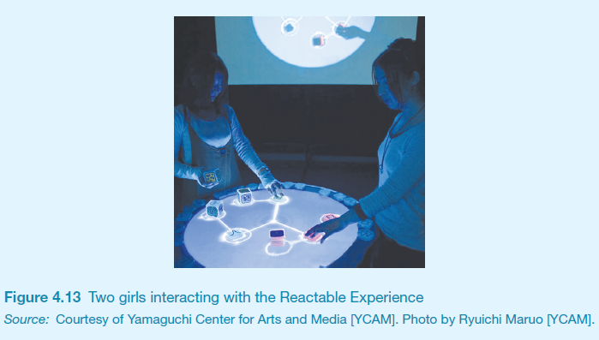
The Reactable experience

Slide 33
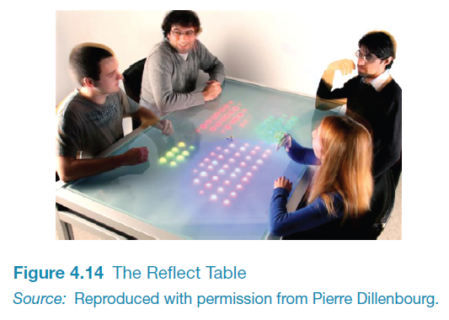
The Reflect Table

Slide 34
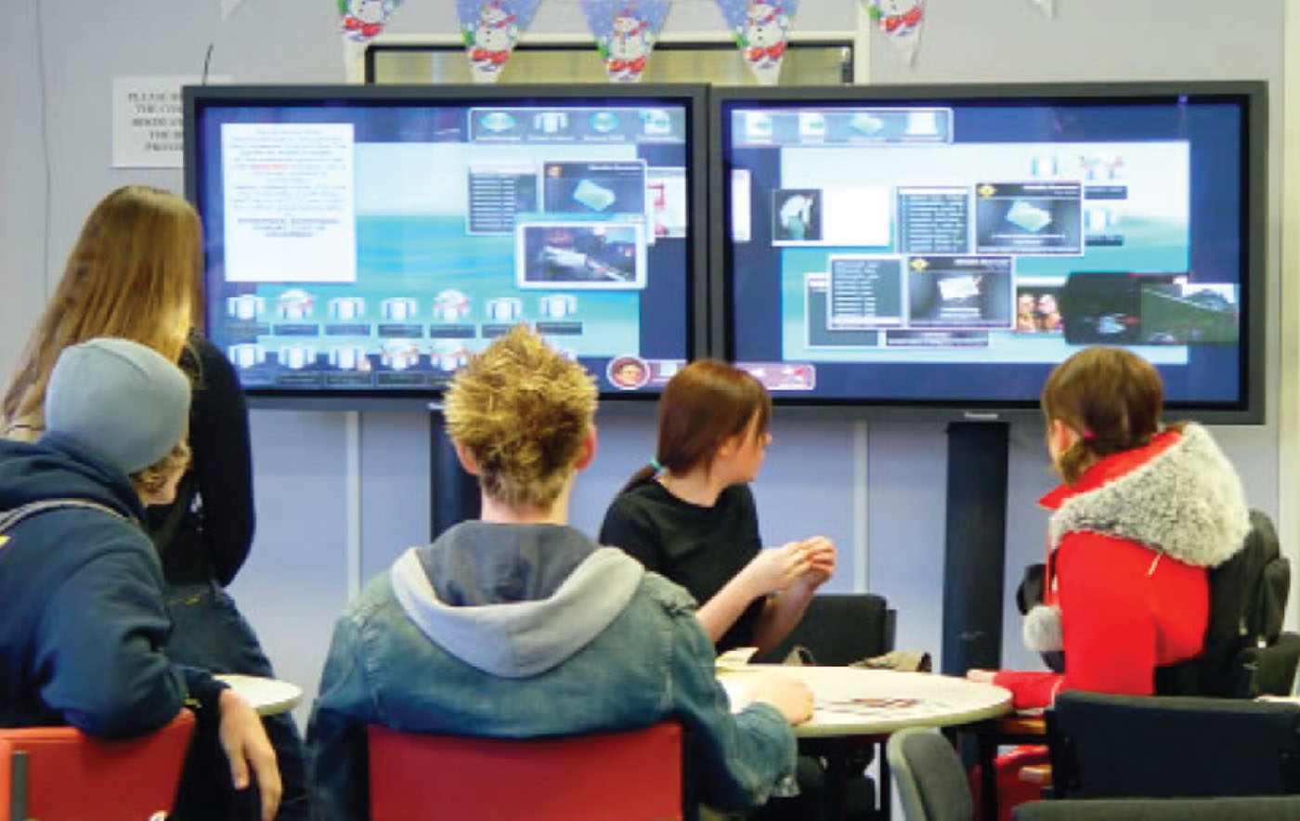
The Dynamo system

Slide 35
Notification systems
Users notify others as opposed to being constantly monitored
Provide information about shared objects and progress of collaborative tasks
example: Babble

Slide 36
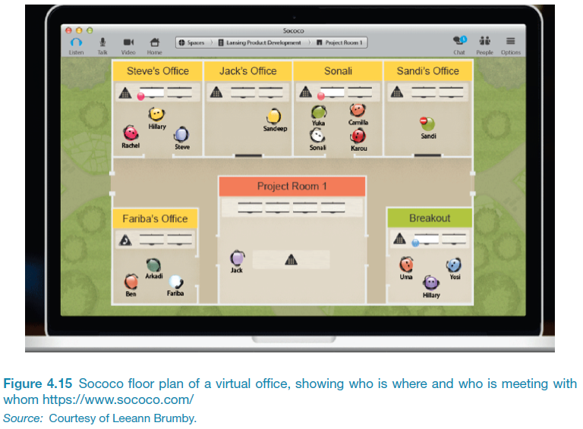
Sococo – shows who is where and who is meeting with whom

Slide 37
What next?
Besides perpetual sharing and broadcasting of information, knowledge, and personal content?
Lifelogging
recording everything in one’s life and sharing
Micro-chatting
beyond twitter and snapchat?

Slide 38
Summary
Social mechanisms, like turn-taking, conventions, etc., enable us to collaborate and coordinate our activities
Keeping aware of what others are doing and letting others know what you are doing are important aspects of collaborative working and socialising
Many technologies systems have been built to support telepresence and co-presence

